Slide 1
Review: Pressure Drop in PBRs
A → B -r_{A} = kC_{A}
1st order reaction rate
dX_{A}/dW for an isothermal ideal gas phase reaction with ΔP
Mole balance
Rate law
Stoichiometry (put C_{A} in terms of X)
0
Pressure drop (put P/P₀ in terms of X)
Only for ε=0
& Isothermal
Combine
Process is like an onion → layer built upon layer
& sometimes it makes you cry

Slide 2
Review: Pressure Drop in PBRs
A → B -r_{A} = kC_{A}
1st order reaction rate
dX_{A}/dW for an isothermal ideal gas phase reaction with ΔP
Mole balance
Rate law
Stoichiometry (put C_{A} in terms of X)
0
Pressure drop (put P/P₀ in terms of X)
Only for ε=0
& Isothermal
Combine
How do we determine the reaction order?

Slide 3
L8: Analysis of Rate Data
Goal: how to determine rate laws
In practice, collection and analysis of rate data is the most time consuming task in reactor design
BMB
Kinetics
Stoichiometry
Fluid dynamics
Reactor design problem
Reactor volume
BMB
Reactor Volume
Stoichiometry
Fluid dynamics
BEFORE
Reactor design problem
Kinetics

Slide 4
Review of Rate Laws
The reaction:
is elementary and irreversible. Which of the following is true?
The rate cannot be determined from this information
None of the above
Ethanol and acetic acid react to form ethyl acetate and water. The rate of ethyl acetate formation is 1st order in ethanol conc and
0th order in acetic acid conc. Which of the following is true?
r_{ethyl acetate} = kC_{ethyl} _{acetate}C_{water}
r_{ethyl acetate} = kC_{ethanol}C_{acetic acid}
r_{ethyl acetate} = kC_{ethanol}
r_{ethyl acetate} = kC_{acetic acid}
r_{ethyl acetate} = kC_{ethanol}²C_{acetic acid}⁻¹
←C_{acetic} _{acid}⁰ (zero power) = 1

Slide 5
Collection & Analysis of Rate Data
Data collection is done in the lab, where we can simplify BMB, stoichiometry, and fluid dynamic considerations
  Goal: determine reaction order, α, and specific reaction rate constant, k, in the rate law
Want ideal conditions → well-mixed (data is easiest to interpret)
Select a simple reactor
Constant-volume batch reactor
  For homogenous reactions
  Concentration vs. time measurements
  Measurement during the unsteady-state operation
Differential reactor
  For solid-fluid reactions
  Measurement during steady state operation
  Product concentration is usually monitored for different feed conditions

Slide 6
Method of Excess
A + B → products Suspect rate eq. -r_{A} = kC_{A}^{α}C_{B}^{β}
Run reaction with an excess of B so C_{B} ≈ C_{B0}
Rate equation simplifies to –r_{A} = k’C_{A}^{α} where k’=k_{A}C_{B}^{β} ≈ k’=k_{A}C_{B0}^{β} and α can be determined
Repeat, but with an excess of A so that C_{A} ≈ C_{A0}
With excess A, rate simplifies to –r_{A} = k’’C_{B}^{β} where k’’=k_{A}C_{A}^{α} ≈ k’’=k_{A}C_{A0}^{α}
Determine k_{A} by measuring –r_{A} at known concentrations of A and B, where

Slide 7
Analysis Methods
Differential method
Integral method
Half-lives method
Initial rate method
Differential reactor
More complex kinetics

Slide 8
Differential Method
0
0
alpha power
Where –r_{A} = kC_{A}^{α}
Average slope
Plot ΔC_{A}/Δt as a function of t
Determine dC_{A}/dt from plot by graphical or numerical methods
Plot ln(-dC_{A}/dt) vs ln C_{A}
Slope = α
To find k, find the value of –dC_{A,p}/dt that corresponds to a specific concentration C_{A,p}. Raise C_{A,p} to the α power and divide into –dC_{A}/dt)_{p}
Hey, we just jumped from step a to step c. How do we get dC_{A}/dt?

Slide 9
Graphical Method
Plot ΔC_{A}/Δt vs t
Draw rectangles on the graph. Then draw a curve so that the area above the curve that is cut off of each rectangle approximately fills the unfilled area under the curve
(−ΔC_{A}/Δt)_{t=0}
(−ΔC_{A}/Δt)_{t=1}
(−ΔC_{A}/Δt)_{t=2}
dC_{A}/dt is read using the value where the curve crosses a specified time
0
t₁
t₂

Slide 10
Graphical Method Example
C_{A} | t | Δt | ΔC_{A} | −ΔC_{A}/Δt | -dC_{A}/dt
8 | 0
4 | 1
2 | 2
1 | 3

Slide 11
Graphical Method Example
C_{A} | t | Δt | ΔC_{A} | −ΔC_{A}/Δt | -dC_{A}/dt
8 | 0 | 1-0=1
4 | 1 | 2-1=1
2 | 2 | 1
1 | 3

Slide 12
Graphical Method Example
C_{A} | t | Δt | ΔC_{A} | −ΔC_{A}/Δt | -dC_{A}/dt
8 | 0 | 1 | 4-8= -4
4 | 1 | 1 | 2-4= -2
2 | 2 | 1 | 1-2= -1
1 | 3

Slide 13
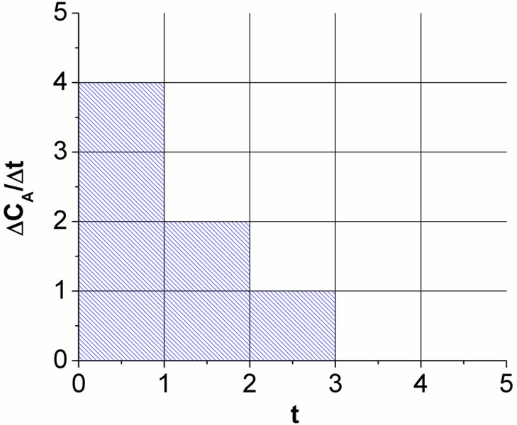
Graphical Method Example
C_{A} | t | Δt | ΔC_{A} | −ΔC_{A}/Δt | -dC_{A}/dt
8 | 0 | 1 | -4 | 4
4 | 1 | 1 | -2 | 2
2 | 2 | 1 | -1 | 1
1 | 3
C_{A} | t | Δt | ΔC_{A} | −ΔC_{A}/Δt
8 | 0 | 1 | -4 | 4
4 | 1 | 1 | -2 | 2
2 | 2 | 1 | -1 | 1
1 | 3
-

Slide 14
Graphical Method Example
C_{A} | t | Δt | ΔC_{A} | −ΔC_{A}/Δt | -dC_{A}/dt
8 | 0 | 1 | -4 | 4 | 4.5
4 | 1 | 1 | -2 | 2 | 2.55
2 | 2 | 1 | -1 | 1 | 1.35
1 | 3 |  |  |  | 0.5
C_{A} | t | Δt | ΔC_{A} | −ΔC_{A}/Δt
8 | 0 | 1 | -4 | 4
4 | 1 | 1 | -2 | 2
2 | 2 | 1 | -1 | 1
1 | 3
-

Slide 15
Graphical Method Example
C_{A} | t | Δt | ΔC_{A} | −ΔC_{A}/Δt | -dC_{A}/dt
8 | 0 | 1 | -4 | 4 | 4.5
4 | 1 | 1 | -2 | 2 | 2.55
2 | 2 | 1 | -1 | 1 | 1.35
1 | 3 |  |  |  | 0.5
Plot ln(-dC_{A}/dt) vs ln C_{A}
-
Slope = α

Slide 16
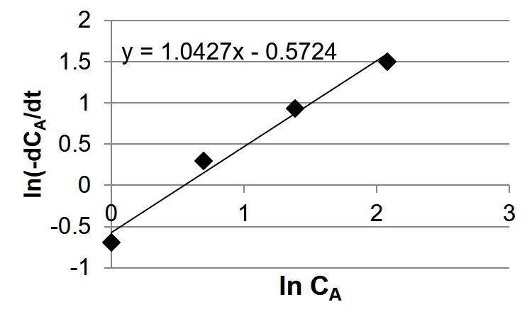
Graphical Method Example
C_{A} | t | Δt | ΔC_{A} | −ΔC_{A}/Δt | -dC_{A}/dt | ln(-dC_{A}/dt) | ln(C_{A})
8 | 0 | 1 | -4 | 4 | 4.5 | 1.5 | 2.1
4 | 1 | 1 | -2 | 2 | 2.55 | 0.9 | 1.4
2 | 2 | 1 | -1 | 1 | 1.35 | 0.3 | 0.7
1 | 3 |  |  |  | 0.5 | -0.7 | 0
Plot ln(-dC_{A}/dt) vs ln C_{A}
Slope = α
= 1.0
-r_{A}= (0.6/time)C_{A}

Slide 17
Graphical Method Example
C_{A} | t | Δt | ΔC_{A} | −ΔC_{A}/Δt | -dC_{A}/dt
8 | 0 | 1 | -4 | 4 | 4.5
4 | 1 | 1 | -2 | 2 | 2.55
2 | 2 | 1 | -1 | 1 | 1.35
1 | 3 |  |  |  | 0.5
Slope = α
Differential Method
Only for irreversible reactions
Advantages: 1 experiment
Disadvantages: can only handle simple kinetics
-
-

Slide 18
Analysing methods
Differential method
Integral method
Half-lives method
Initial rate method
Differential reactor
More complex kinetics

Slide 19
Integral Method
A trial-and-error procedure to find reaction order
Guess the reaction order → integrate the differential equation
Method is used most often when reaction order is known and it is desired to evaluate the specific reaction rate constants (k) at different temps to determine the activation energy
Looking for the appropriate function of concentration corresponding to a particular rate law that is linear with time

Slide 20
For the reaction A → products
For a zero-order reaction -r_{A} = k
Plot of C_{A} vs t is a straight line
C_{A}
t
For a first-order reaction - r_{A} = k C_{A}
ln (C_{A0}/C_{A})
Plot of ln(C_{A0}/C_{A}) vs t is a straight line
t
For a second-order reaction - r_{A} = k C_{A}²
1/C_{A}
Plot of 1/C_{A} vs t is a straight line
t

Slide 21
Analysis Methods
Differential method
Integral method
Half-lives method
Initial rate method
Differential reactor
More complex kinetics

Slide 22
Method of Half-lives
The half-life of a reaction, t_{1/2}, is defined as the time it takes for the concentration of the reactant to fall to half of its initial value
By determining the half-life of a reaction as a function of the initial concentration, the reaction order and specific reaction rate can be determined

Slide 23
Method of Half-lives
The half-life of a reaction, t_{1/2}, is defined as the time it takes for the concentration of the reactant to fall to half of its initial value
By determining the half-life of a reaction as a function of the initial concentration, the reaction order and specific reaction rate can be determined

Slide 24
A → products
ln (t_{1/2})
Slope = 1- α
ln C_{A0}
Plot ln(t_{1/2}) vs ln C_{A0}. Get a straight line with a slope of 1-α

Slide 25
Analysis Methods
Differential method
Integral method
Half-lives method
Initial rate method
Differential reactor
More complex kinetics

Slide 26
Method of Initial Rates
When the reaction is reversible, the method of initial rates can be used to determine the reaction order and the specific rate constant
Very little product is initially present, so rate of reverse reaction is negligible
  A series of experiments is carried out at different initial concentrations
  Initial rate of reaction is determined for each run
  Initial rate can be found by differentiating the data and extrapolating to zero time
  By various plotting or numerical analysis techniques relating -r_{A0} to C_{A0}, we can obtain the appropriate rate law:

Slide 27
Example: Initial Rate Method
The dissolution of dolomite using hydrochloric acid:
4HCl + CaMg(CO₃)₂ → Mg²⁺ + Ca²⁺ + 4Cl⁻+2CO₃ + 2H₂O
Concentration of HCl at various times was determined from atomic
absorption spectrophotometer measurements of the Ca²⁺ and Mg²⁺ ions
4 N HCl
C_{HCl}
1 N HCl
Make a plot of ln (-r_{A0}) vs ln C_{A0}
The slope = α
t

Slide 28
Evaluating the mole balance on a constant V batch reactor at t = 0:
Plot of ln (-r_{HCl,0}) vs ln C_{HCl,0} will give reaction order α & k
ln (-r_{HCl,0})
Slope = α
ln (C_{HCl})

Slide 29
Analysis Methods
Differential method
Integral method
Half-lives method
Initial rate method
Differential reactor
More Complex Kinetics

Slide 30
Differential Reactors
The criterion for a reactor being differential is that the conversion of the reactants in the bed is extremely small, as is the change in reactant concentration through the bed
Reactant concentration through the reactor is essentially constant (i.e. the reactor is considered to be gradient-less)
Can treat the mole balance like a CSTR
Rate of reaction determined for a specified number of pre-determined initial or entering reactant concentrations
Determine rate of reaction as a function concentration or partial pressure
Operate isothermally
C_{A0}
C_{A}
C_{Ae}
C_{A0} ~ C_{A}~ C_{Ae}

Slide 31
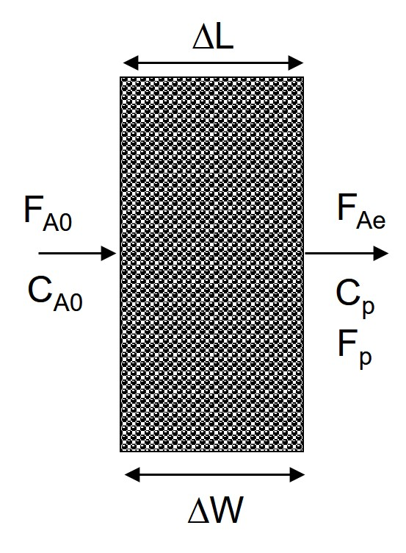
Differential Catalyst Bed
The rate of reaction per unit mass of catalyst, r’_{A}
flow rate in - flow rate out + rate of generation = rate of accumulation
When constant flow rate, υ₀ = υ:
Product concentration
The reaction rate is determined by measuring product concentration, C_{p}

Slide 32
More Complex Kinetics
Carry out batch experiments
Use optimization software to compute kinetic parameters by least squares (covered in process control)
Investigate errors by calculating standard deviations of parameters and looking at magnitudes of r_{a,meas,i} –r_{A, calc,i} to look for outliers (will learn in process design, this is FYI for this class
If parameters are sufficiently accurate, then stop. If not, keep repeating the procedure
Sum of squares difference between the measured values and calculated values

